Slide 1


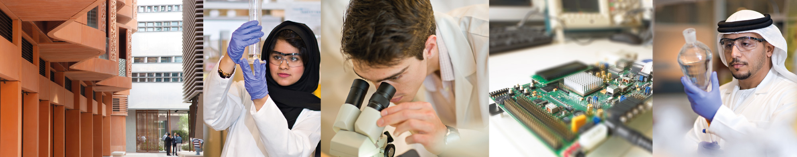
Thermal Energy Storage (TES) applied to Concentrated Solar Power (CSP) UCC501 – Part 2
Dr. Nicolas CALVET
Assistant Professor
Thermal energy Storage Group Leader
iEnergy Center
Department of Mechanical and Materials Engineering (MME)

Slide 2

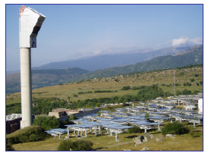
TES applied to CSP
Concentrated Solar Power Technologies
Parabolic trough Power tower
Dr. Nicolas CALVET
Notes:
INDICE DE CADA APARTADO

Slide 3
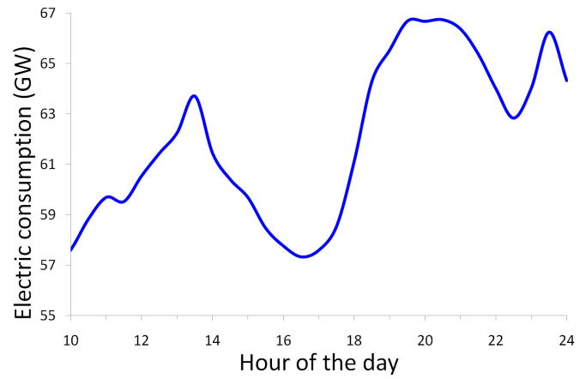

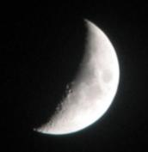

TES applied to CSP
Needs in TES?
^{3. Customer side}
^{1. Solar intermitencies}
^{4. Reduce the electricity} ^{cost}
^{2. Daily solar curve}
50
40
30
20
10
0
MW
Storage
Direct
Sun
0 2 4 6 8 10 12 14 16 18 20 22 24
Hybridation using fossil fuel
Discharge from storage
Dr. Nicolas CALVET

Slide 4
TES applied to CSP
How to store Thermal Energy?
Methods
Physical processes
Chemical processes
Sensible Heat
Latent Heat
Chemical Energy
All Operating CSP plants use
sensible heat storages
Dr. Nicolas CALVET

Slide 5
TES applied to CSP
How to store Thermal Energy?
Sensible Heat
Latent Heat
Temperature
Temperature
Stored heat
Stored heat
Dr. Nicolas CALVET

Slide 6




TES applied to CSP
Comparison Sensible & Latent Heat
Concrete
(15)
DT = 15 K
in sensible heat
Same Stored Energy
Concrete (11)
Water (6)
Water
(4)
Organics
PCM
(1.25)
Organic PCM
(2.5)
Inorganics PCM (1)
Inorganics PCM (1)
In relative mass In relative volume
Dr. Nicolas CALVET

Slide 7
TES applied to CSP
Thermochemical Storage System (TCS)
Charge
Discharge
B
Endothermic
Reactor
A + ΔH_{R} → B + C
Exothermic
Reactor
B+C → A + ΔH_{R}
Concentrated Solar Energy
ΔH_{R}
C
ΔH_{R}
Storage
A
Power Block
ΔH_{R}
Very high storage density compared to sensible & Latent heat
Dr. Nicolas CALVET

Slide 8
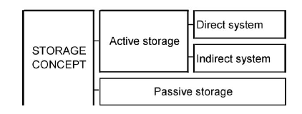
TES applied to CSP
How to store Thermal Energy?
Storage Fluid = Heat Transfer Fluid (HTF) Storage Fluid ≠ Heat Transfer Fluid (HTF)
Tested Technologies
Commercial Technologies
Under Development
Under Research
Dr. Nicolas CALVET
Notes:
INDICE DE CADA APARTADO

Slide 9

Tested Technologies
TES applied to CSP
Dr. Nicolas CALVET

Slide 10
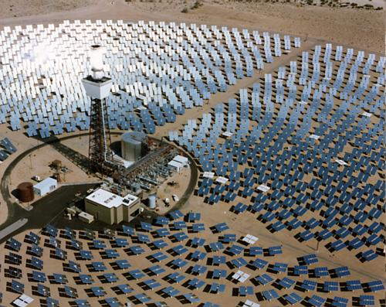
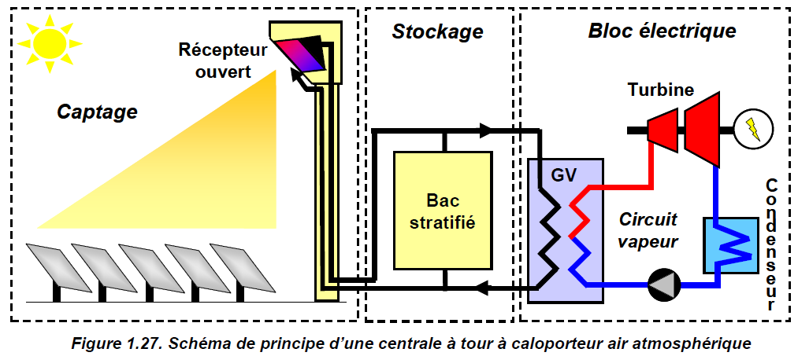
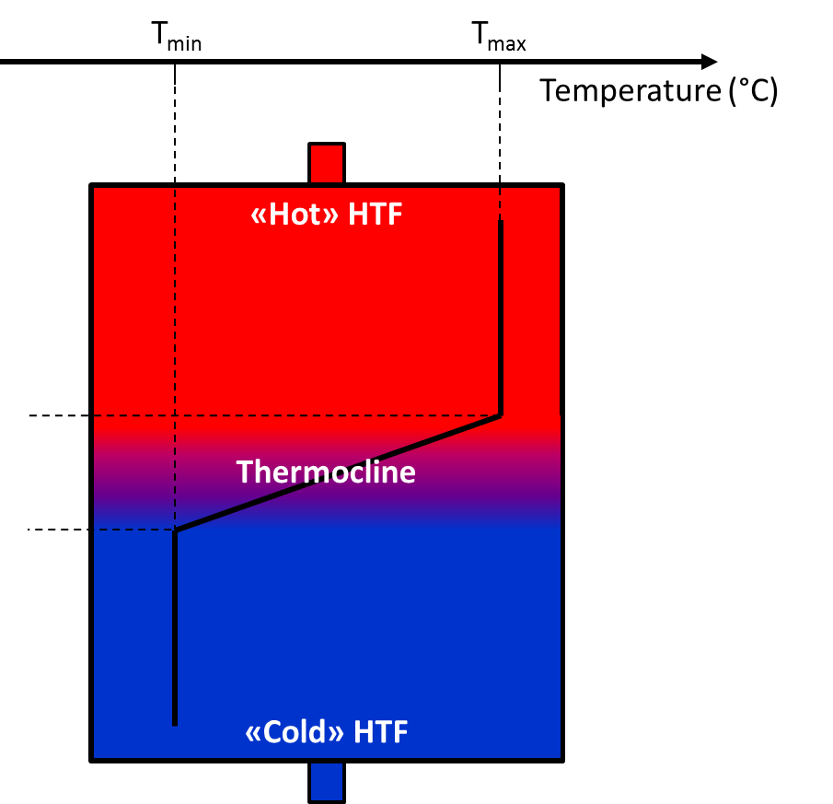
TES applied to CSP
Tested Technologies
1.1. Active Direct Storage – Single Tank Oil Thermocline + Filler Materials
Solar One, Mojave desert, CA, USA
(10 MW_{el} , 1982-1988)
Rocks and sand, oil as the HTF
Dr. Nicolas CALVET

Slide 11
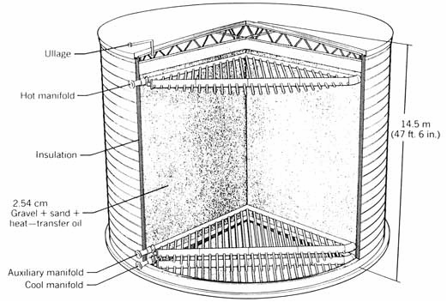
TES applied to CSP
Tested Technologies
1.1. Active Direct Storage – Single Tank Oil Thermocline + Filler Materials
Problem of thermal expansion between the charge and discharge
Dr. Nicolas CALVET

Slide 12
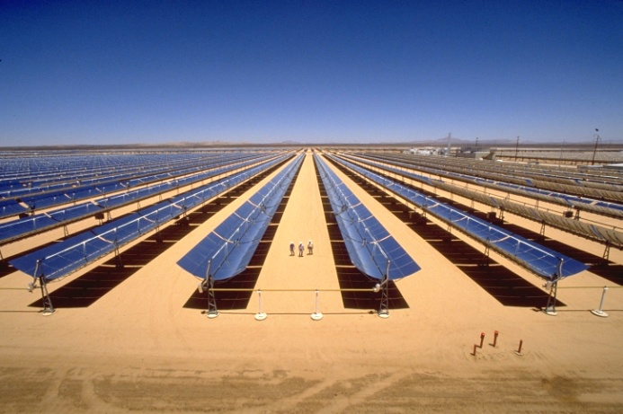
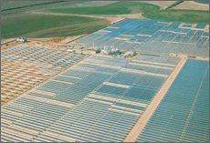
TES applied to CSP
1. Tested Technologies
1.2. Active Direct Storage – Two-tank Oil Technology
SEGS 1
(Solar Energy Generating Systems)
Mojave desert, CA, USA
14 MWe, 3 h storage, 240 - 307 C
Destroyed by fire in 1999
Dr. Nicolas CALVET

Slide 13
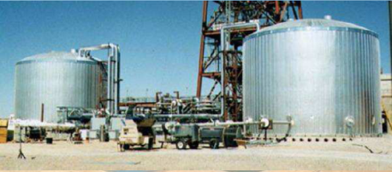
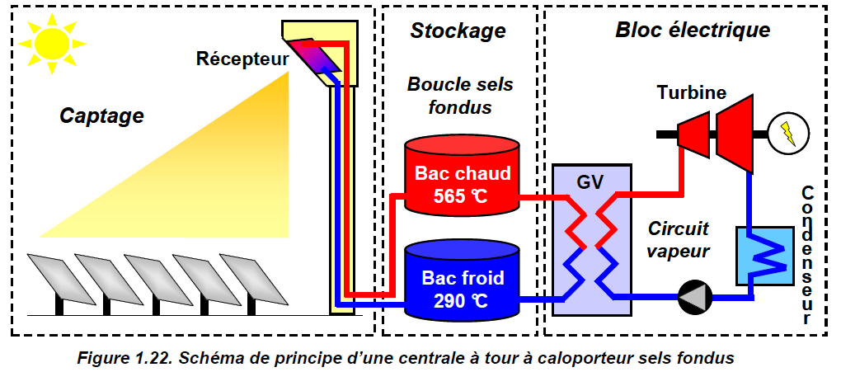
TES applied to CSP
1. Tested Technologies
1.3. Active Direct Storage – Two-tank Molten Salt Technology
THEMIS, Targasone, France
(2.5 MW_{el}, 1983-1986)
Solar two, Mojave desert, CA, USA
(12.4 Mw_{el},1995-1999)
Dr. Nicolas CALVET

Slide 14
Commercial Technologies
TES applied to CSP
Dr. Nicolas CALVET

Slide 15
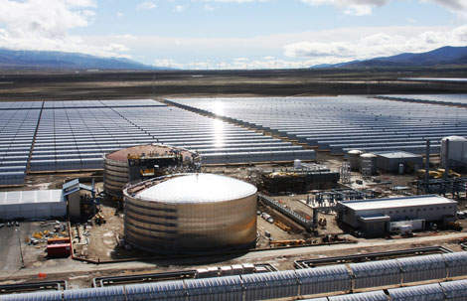


TES applied to CSP
2. Commercial Technologies
2.1. Indirect Two-tank Molten Salt Technology
2008: Andasol 1, First commercial CSP plant with storage
28 500 tons of nitrate salts
(60% NaNO₃, 40% KNO₃)
7.5 h storage, 291-384 ºC
Tank: h= 14 m, D= 36 m
Andasol 1, 50 MWe, Granada, Spain
Dr. Nicolas CALVET

Slide 16
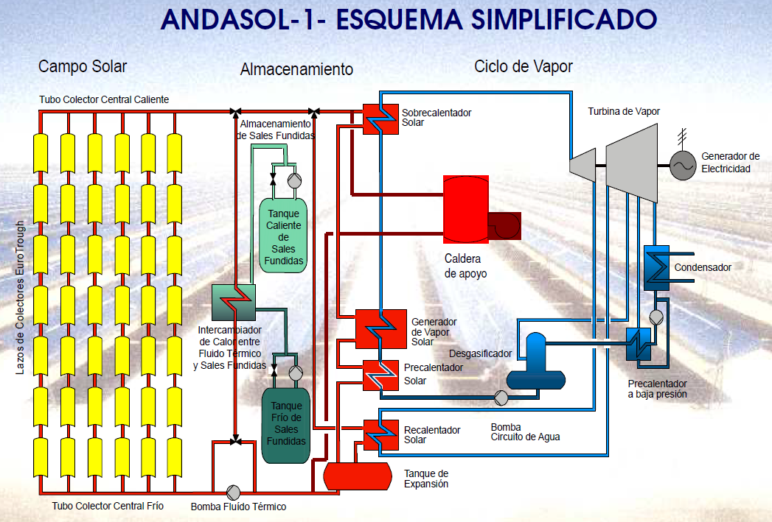
TES applied to CSP
Dr. Nicolas CALVET

Slide 17
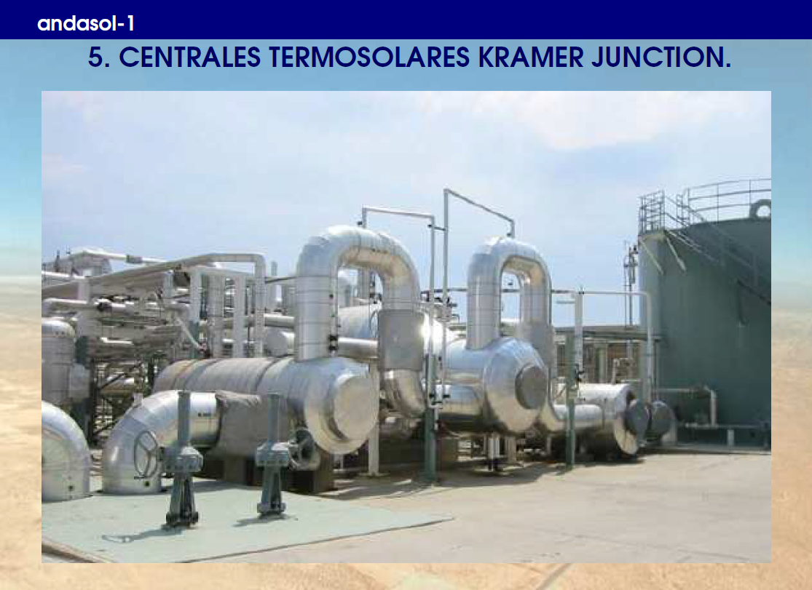
TES applied to CSP
Superheater
Evaporator
Preheater
Dr. Nicolas CALVET

Slide 18
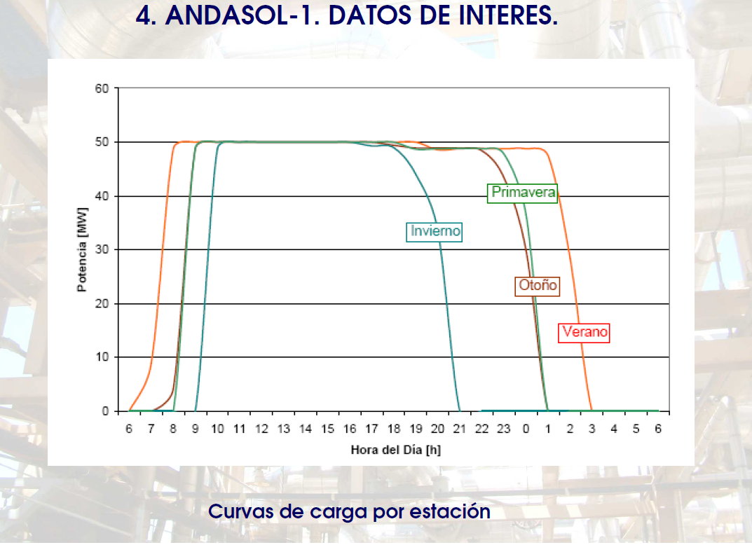
TES applied to CSP
Dr. Nicolas CALVET

Slide 19
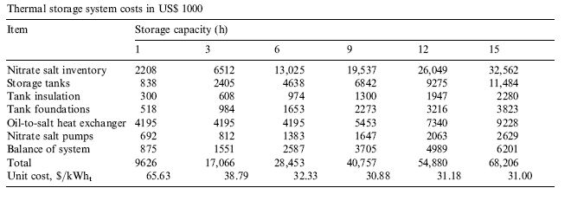
TES applied to CSP
2. Commercial Technologies
2.1. Indirect Two-tank Molten Salt Technology
Andasol 1, 50 MWe, Granada, Spain
500-750 euros/tonne sel
Source: Herrmann 2004

Slide 20
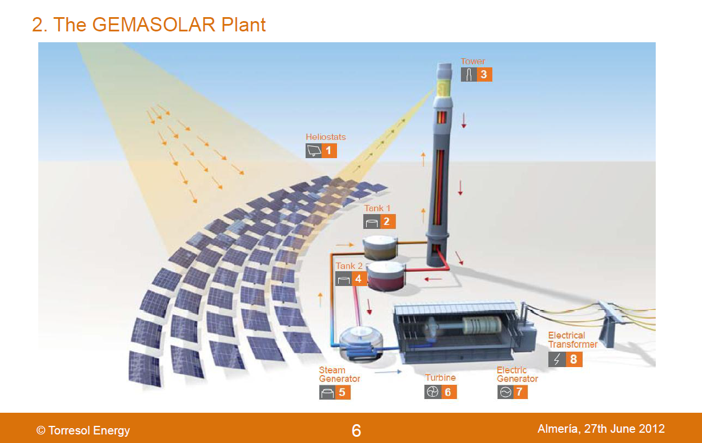

TES applied to CSP
Source: Juan Ignacio Burgaleta, Director of Sener
Dr. Nicolas CALVET

Slide 21
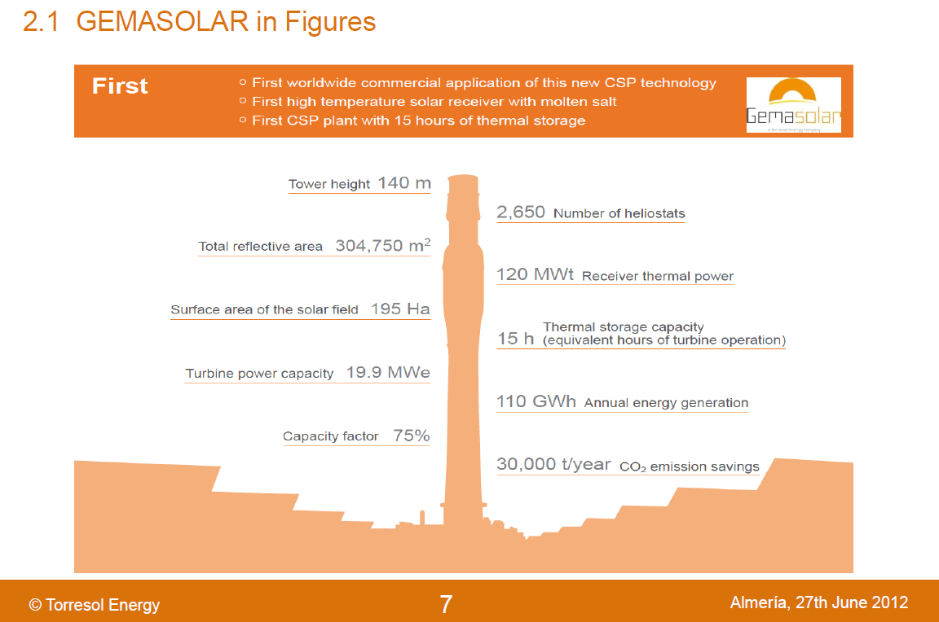
TES applied to CSP
8000 tons of Solar salt
Source: Juan Ignacio Burgaleta, Director of Sener
Dr. Nicolas CALVET

Slide 22
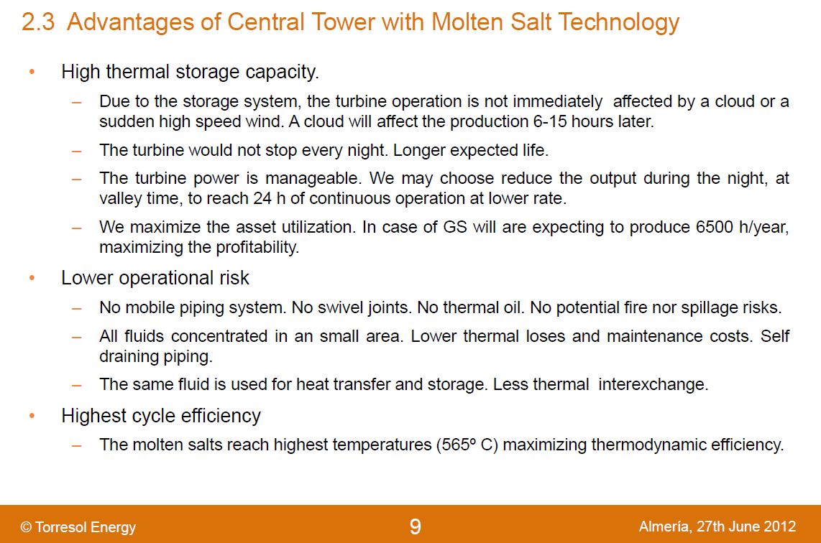
TES applied to CSP
Source: Juan Ignacio Burgaleta, Director of Sener
Dr. Nicolas CALVET

Slide 23
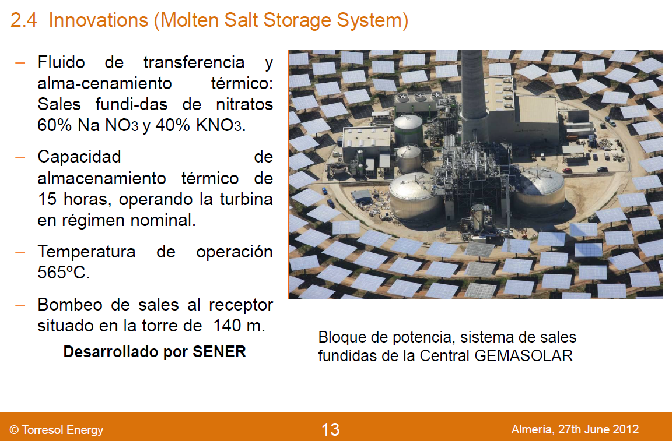
TES applied to CSP
Source: Juan Ignacio Burgaleta, Director of Sener
Dr. Nicolas CALVET

Slide 24
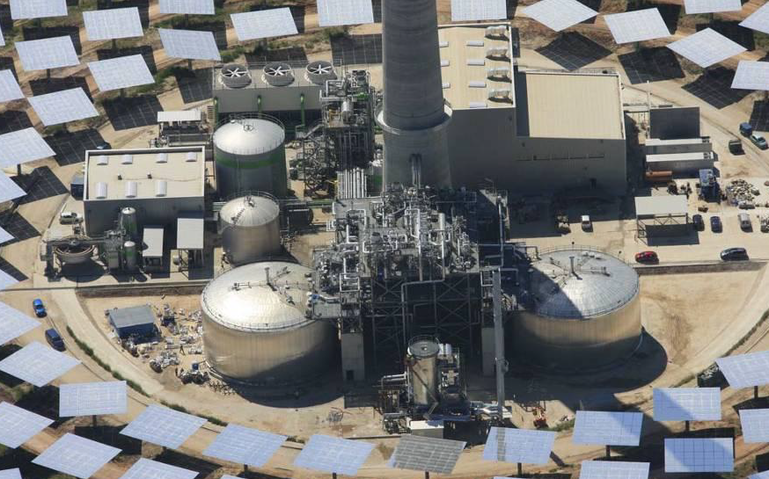
TES applied to CSP
Cooling towers
Power block
Water treatment
Two-tank Molten salt system
Natural gas heater
Salt/Steam heat exchanger
Dr. Nicolas CALVET

Slide 25
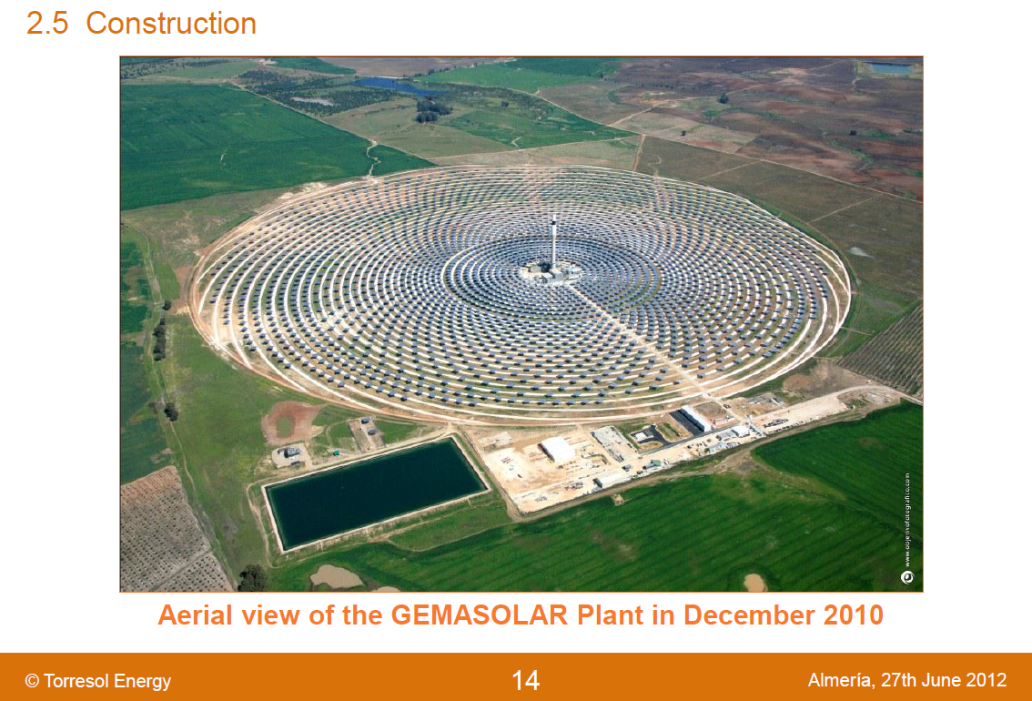
TES applied to CSP
Water can be a problem
Source: Juan Ignacio Burgaleta, Director of Sener
Dr. Nicolas CALVET

Slide 26
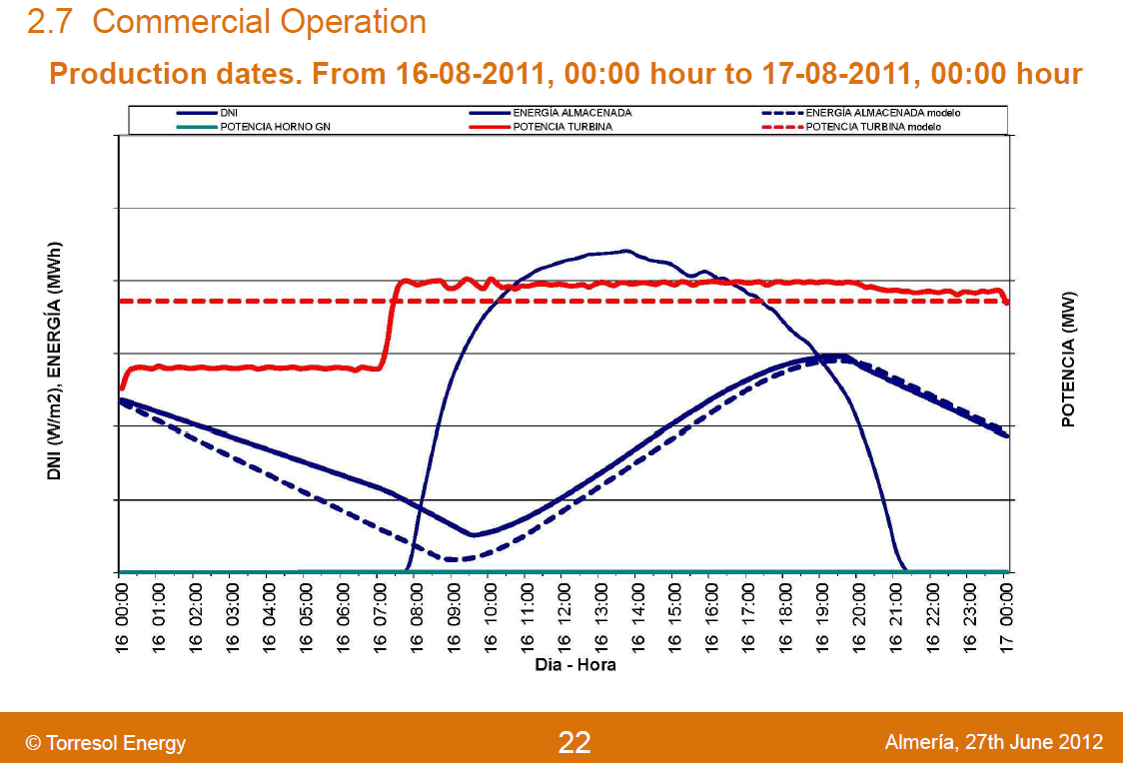
TES applied to CSP
Discharge
Charge
Source: Juan Ignacio Burgaleta, Director of Sener
Dr. Nicolas CALVET

Slide 27
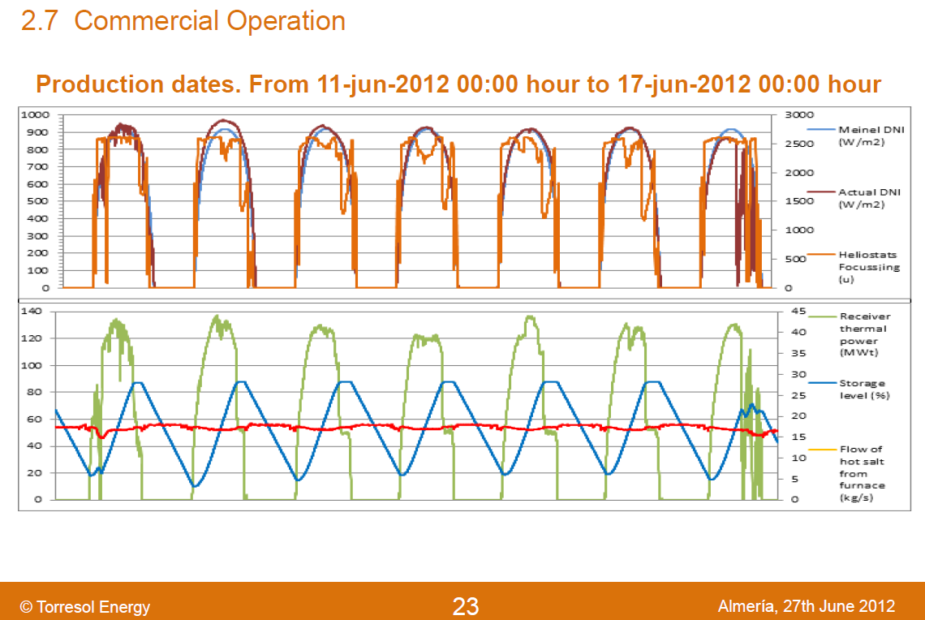
TES applied to CSP
Source: Juan Ignacio Burgaleta, Director of Sener
Dr. Nicolas CALVET

Slide 28

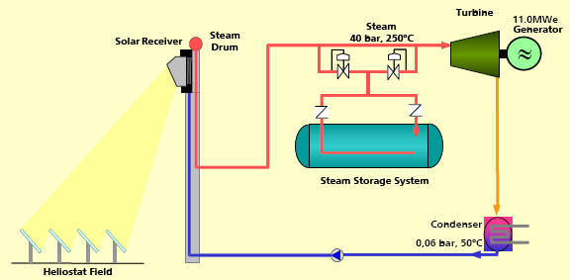
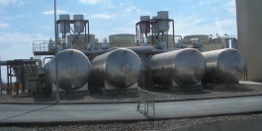
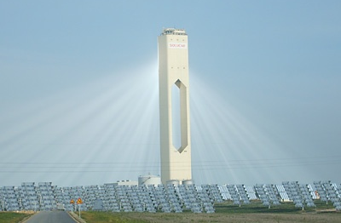
TES applied to CSP
2. Commercial Technologies
2.2. Saturated Steam Storage
Unpredictable
intermittencies
PS10 plant, 11 MWe, Seville
Steam storage
20-30 kWh/m³
100 €/kWh
50 mn at 50 % P
25 MWh
Saturated Steam
40 bars 250°C
Dr. Nicolas CALVET

Slide 29
Under Development
TES applied to CSP
Dr. Nicolas CALVET

Slide 30

TES applied to CSP
3. Under development
3.1 Passive storage: High-temperature Concrete
 | Advantages | drawbacks
Concrete HT | Concrete cost 80 €/tons Easy implementation | Limited to 500 °C 10 years life time Heat exchanger lost Contained Water
Source: Dr. Doerte Laing (DLR)
Dr. Nicolas CALVET

Slide 31
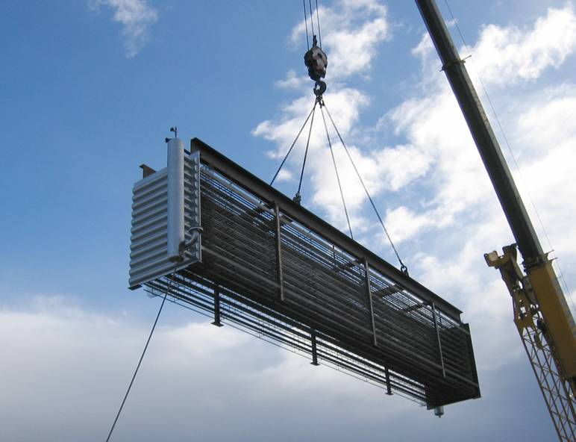
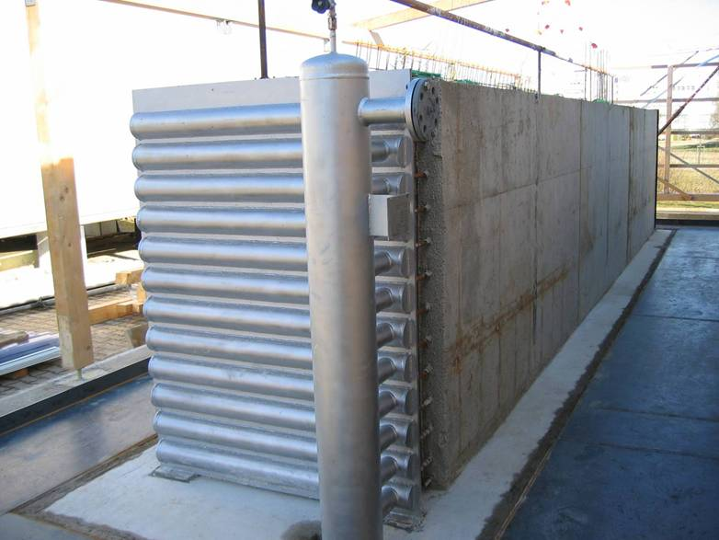
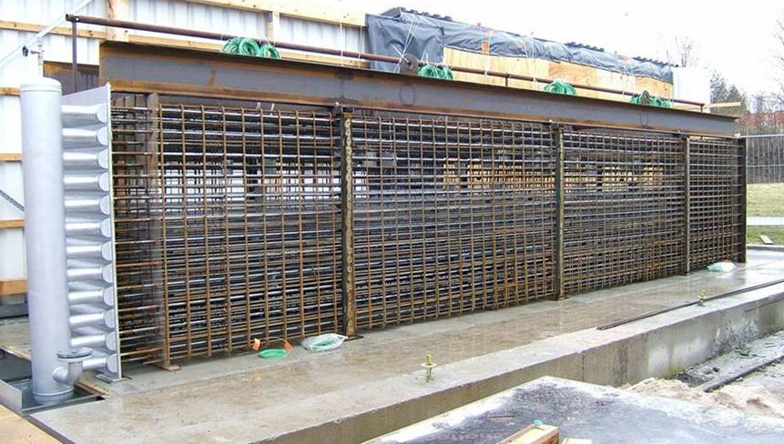
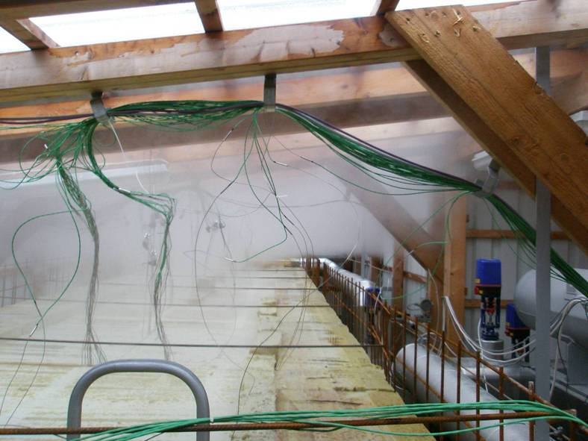
TES applied to CSP
3. Under development
3.1 Passive storage: High-temperature Concrete
Source: Dr. Doerte Laing (DLR)
Dr. Nicolas CALVET

Slide 32
TES applied to CSP
3. Under development
3.1 Passive storage: High-temperature Concrete
390°C Charge 6h 330°C
25 bar
350°C Discharge 6h 290°C
Source: Dr. Doerte Laing (DLR)
Dr. Nicolas CALVET

Slide 33
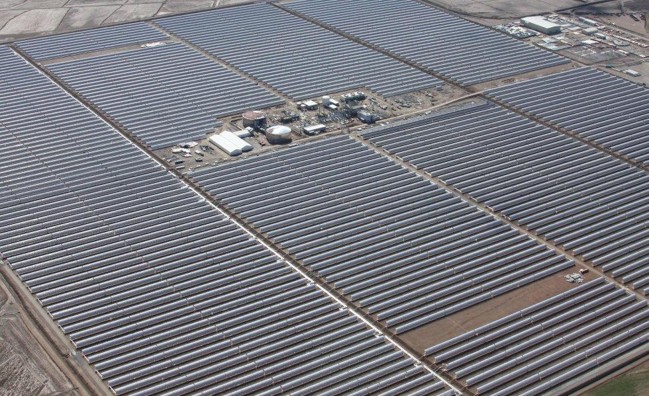
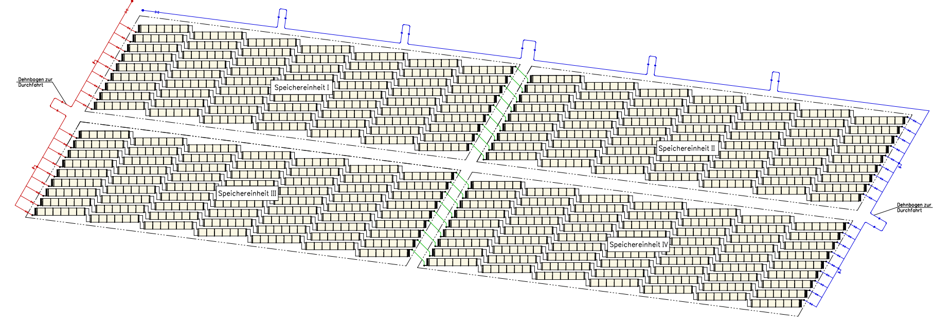
TES applied to CSP
~ 300 m
storage unit
Storage
storage unit
storage unit
storage unit
~ 100 m
Source: Dr. Doerte Laing (DLR)
Dr. Nicolas CALVET
Photo: Solar Millenium AG

Slide 34
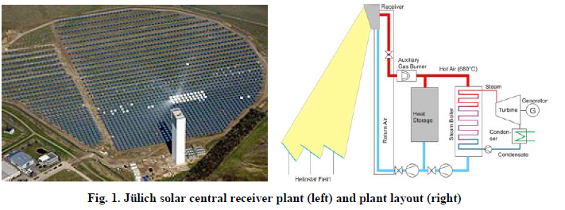
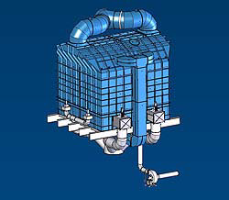
TES applied to CSP
3. Under development
3.2 Passive storage: Regenerator Type Storage
Jüllich, Germany, 2010
Air as HTF
Porous solid ceramics as storage material
1.5 h storage (120 – 680 ºC)
9 MWh (size: 7m x 7m x 6m)
TES unit
Dr. Nicolas CALVET

Slide 35
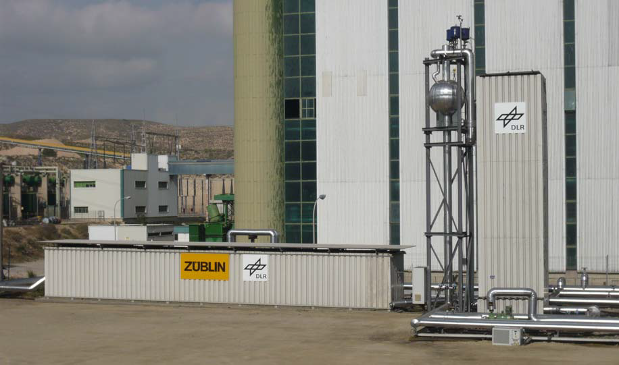
TES applied to CSP
3. Under development
3.3 Passive storage: Combined sensible & Latent heat TES for DSG
Concrete
22m³
300 kWh
PCM
8.5m³
14 tons of NaNO₃
T_{m}=306 °C
700 kWh
Superheating of steam
Evaporation of steam
Demo-storage system (1MWh) with concrete superheater (left) and PCM-Storage (right)
in the water/steam test loop at the power plant Litoral of Endesa in Carboneras, Spain
Dr. Nicolas CALVET

Slide 36
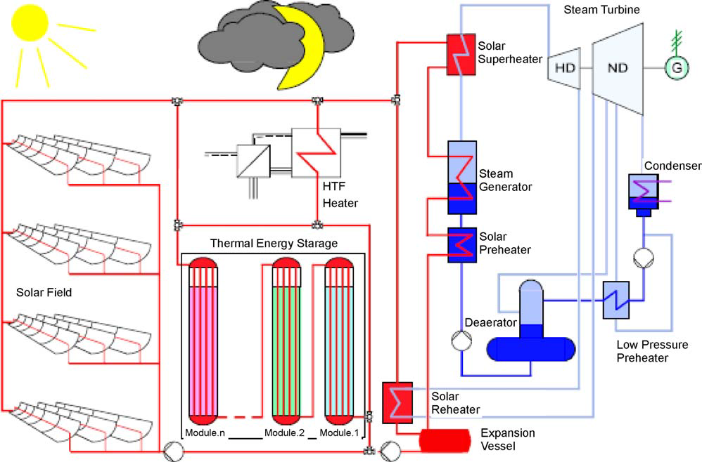
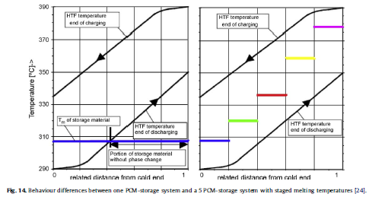
TES applied to CSP
3. Under development
3.4 Passive storage: Cascade Latent Heat Storage (CLHS)
Dr. Nicolas CALVET

Slide 37
Under Research
TES applied to CSP
Dr. Nicolas CALVET

Slide 38
TES applied to CSP
4. Under Research
4.1 Active storage: Fluidized Bed Sand Storage Concept
Advantages | Drawbacks
Sand cost 40€/tons High efficiency | Fluidised bed sand storage Erosion of pipes 10% of CSP energy used
TES unit
Dr. Nicolas CALVET

Slide 39
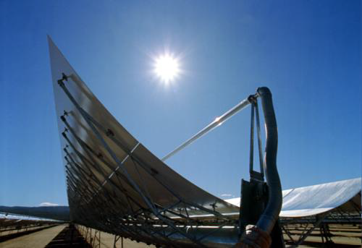
TES applied to CSP
4. Under Research
4.2. Conventional Heat Transfer Fluid (HTF): Synthetic Oil
Upper temperature limitation
Parabolic trough technology | Therminol VP-1®
500 °C | 400 °C
So called Solar oil = (oxide diphenyl 73.5 % and biphenyl 26.5 %)
Fire in the solar field of ANDASOL 1 on December 15th, 2009
Dr. Nicolas CALVET

Slide 40
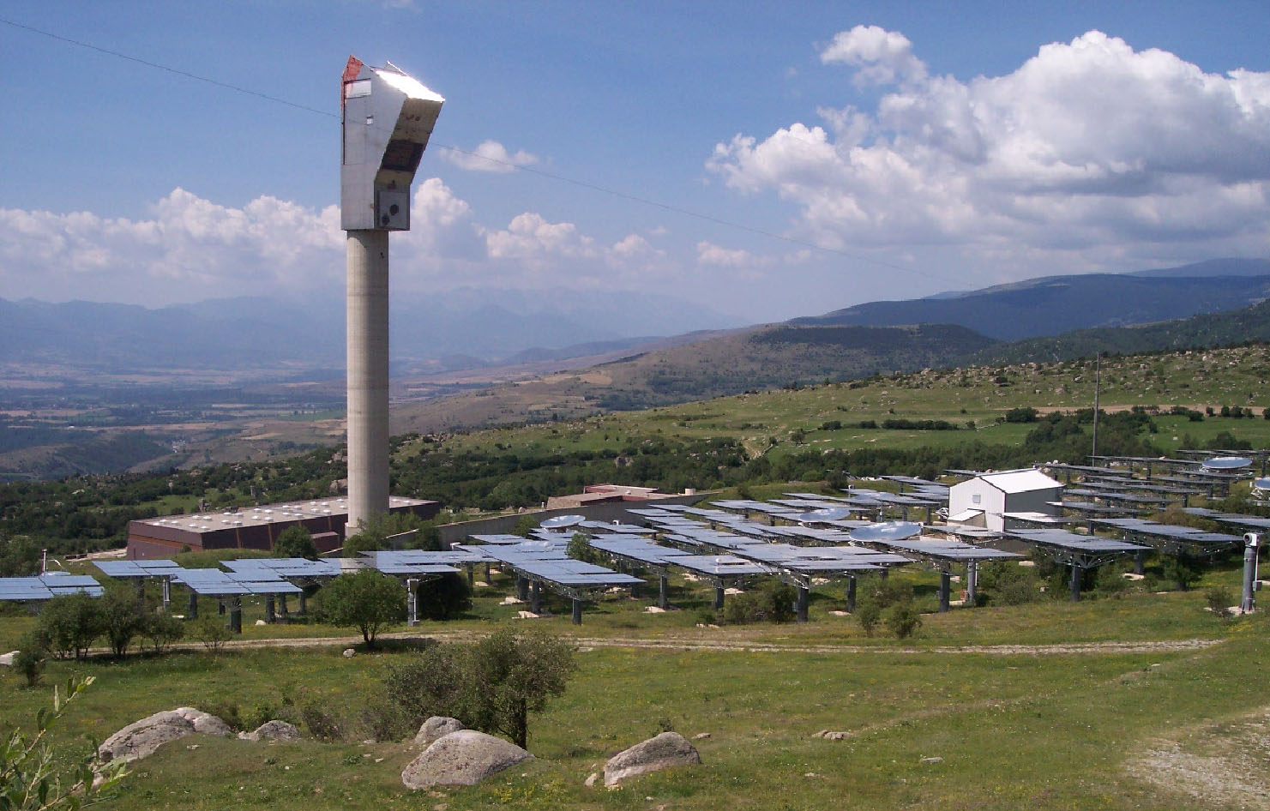
TES applied to CSP
4. Under Research
4.3. Molten salts as HTF in Central Receiver Plants (CRP)
No oil-to-salt heat exchanger
Higher temperature limitation
Higher efficiency
High freezing point
Conventional Molten salts | T_{Max} | Freezing temperature
Hitec® (KNO₃ , NaNO₂ , NaNO₃) | 535°C | 142°C
Solar salt (NaNO₃ , KNO₃) | 600°C | 220°C
Preventing salt crystallization in pipes
Themis CRP in the 80’s:
double envelope with superheated steam
Solar Two CRP in the 90’s:
& Gemasolar nowadays
electric tracing
THEMIS Central Receiver Plant,
Targasone, FRANCE
Dr. Nicolas CALVET

Slide 41
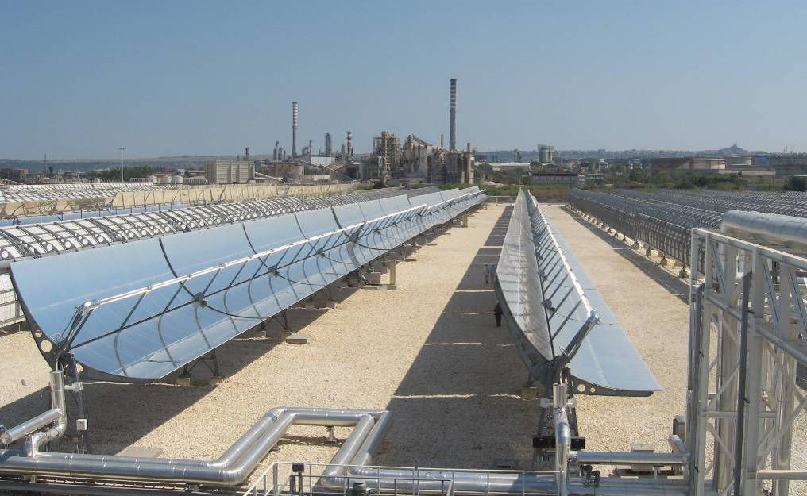
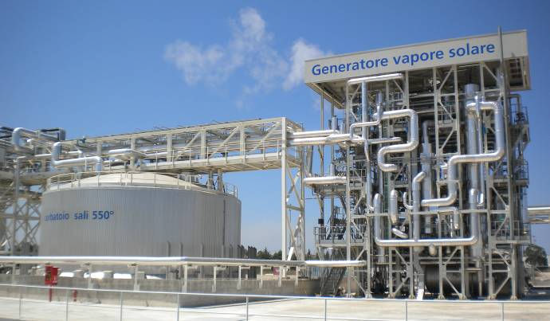
TES applied to CSP
4.3. Molten salts as HTF in Parabolic Trough Plants
4. Under Research
Archimede Plant
Priolo Gargallo, Sicily
5 MW_{el} , 2010
Two tanks molten salts
1580 tons of nitrate salts
(60% NaNO₃, 40% KNO₃)
8 h storage, 290 – 550 ºC
Huge length of parabolic trough collectors (6.4 km) !!
Dr. Nicolas CALVET

Slide 42


TES applied to CSP
4.3. Formulate New Molten salts Compositions
4. Under Research
Lower crystallization temperature
As a promising candidate: Hitec XL® molten salt (Ca(NO₃)₂, NaNO₃, KNO₃) nitrates mixture
Nº | Compositions name | Components wt%
 |  | Ca(NO₃)₂ | NaNO₃ | KNO₃
1 | Coastal C. | 42 | 15 | 43
2 | S. St. Laurent | 30 | 24 | 46
3 | Sandia lab. | 45 | 11 | 44
4 | D. Kearney | 48 | 7 | 45
5 | Eutectic | 44 | 12 | 44
Therminol VP-1® price: 2.2 $/kg
Hitec XL® price: 1.19 $/kg
Dr. Nicolas CALVET

Slide 43
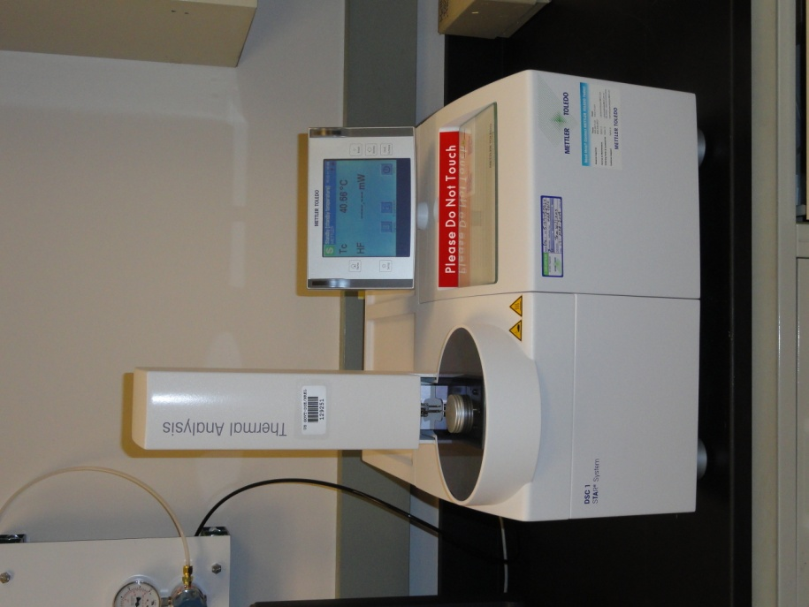
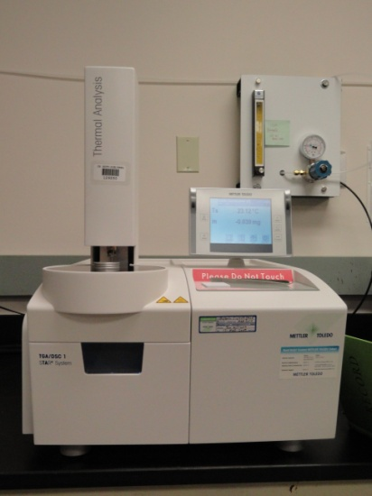
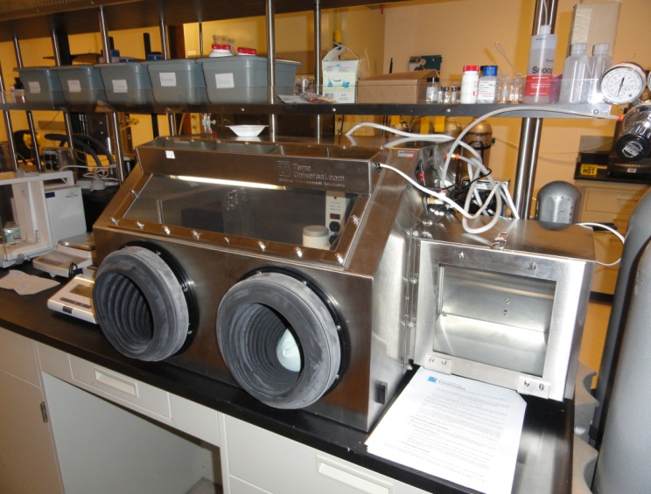
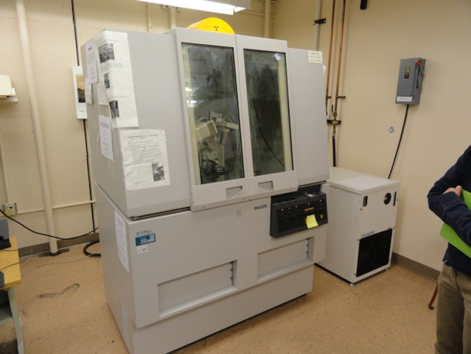
TES applied to CSP
4.3. Formulate New Molten salts Compositions
4. Under Research
Laboratory equipments
Thermal Gravimetric Analyzer (TGA)
Differential Scanning Calorimeter (DSC)
Rheometer
Glove box
X-Ray Diffractions (XRD)
Dr. Nicolas CALVET

Slide 44
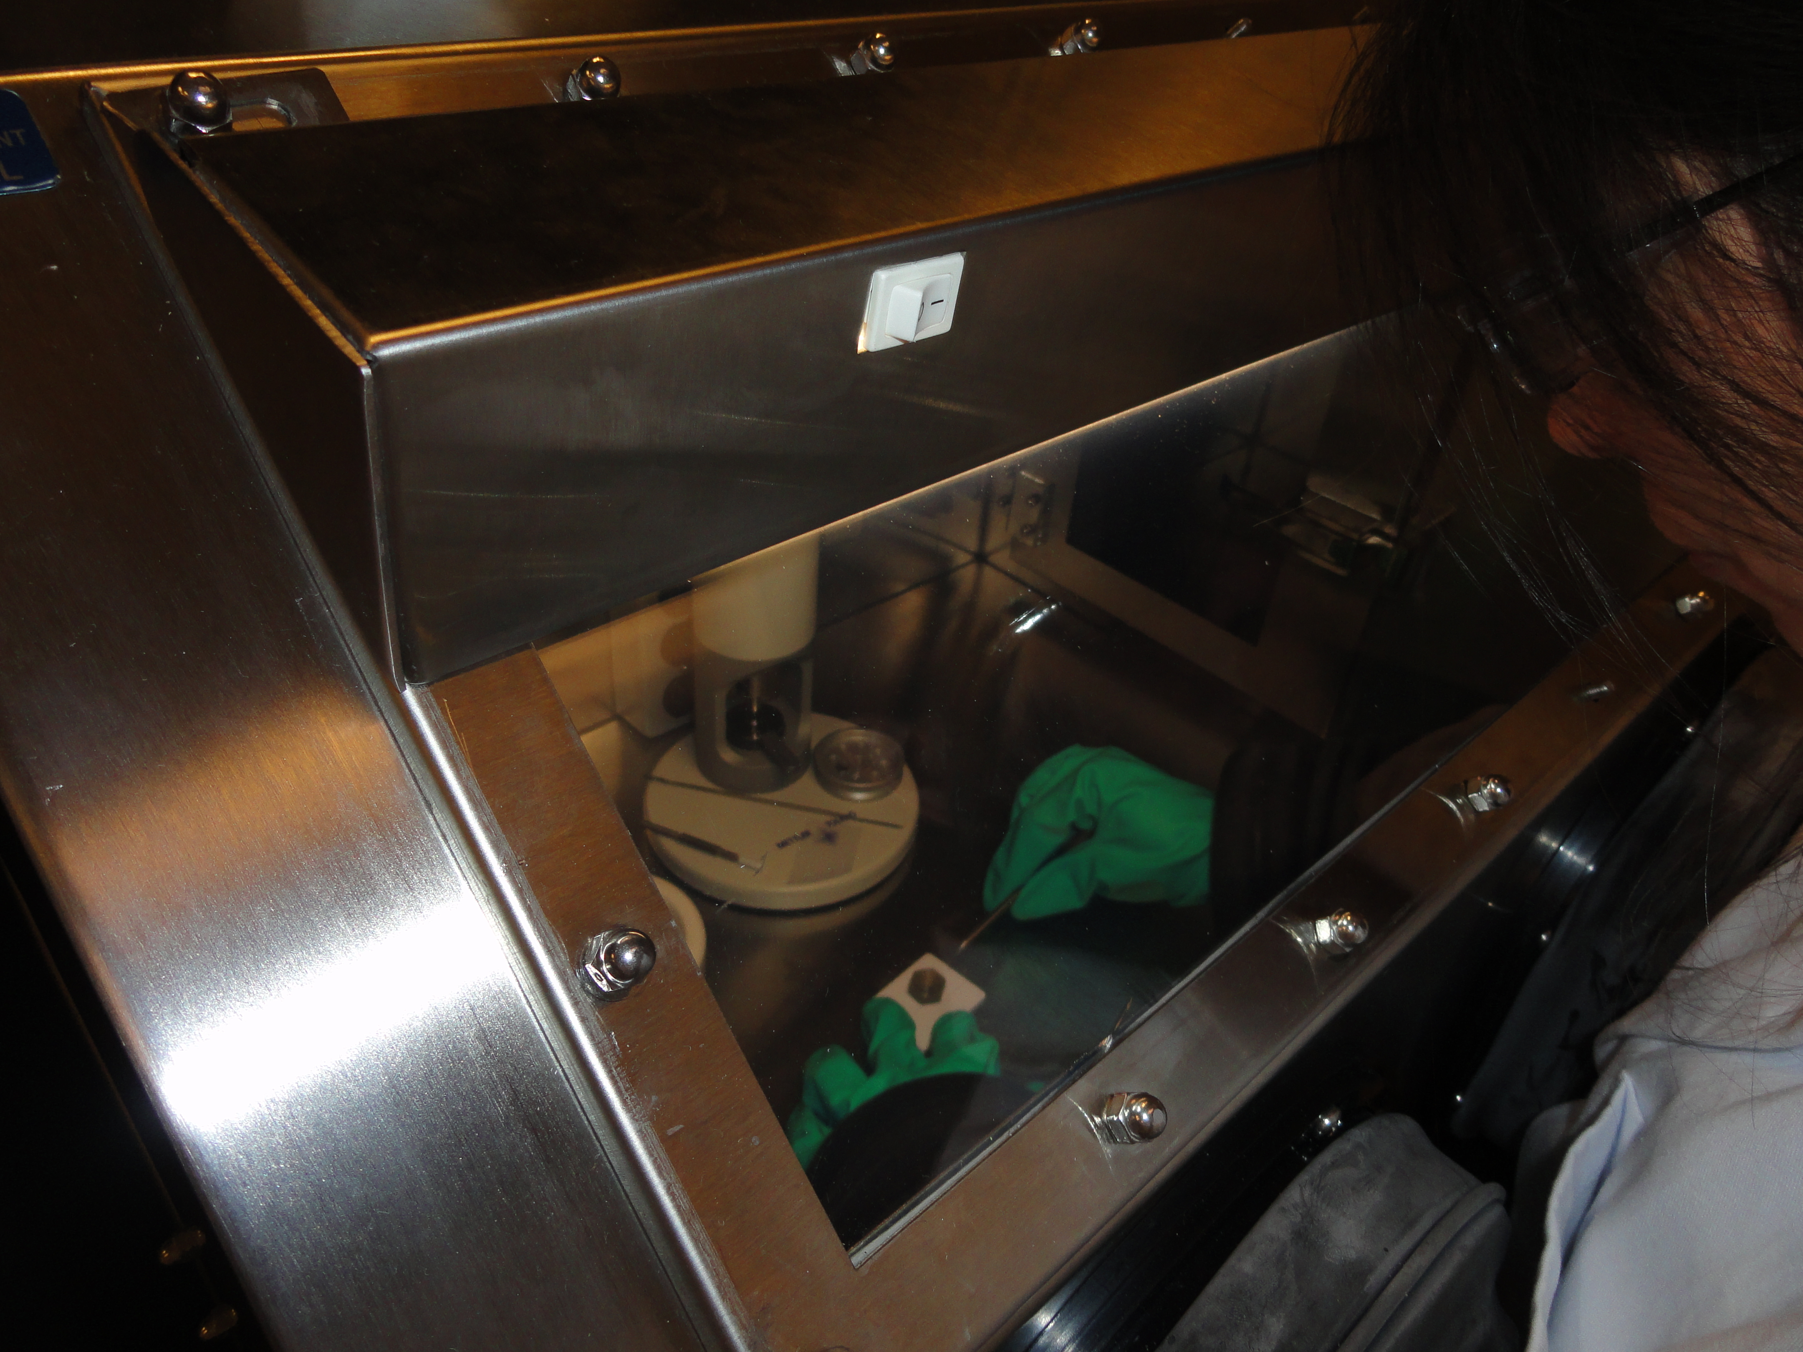
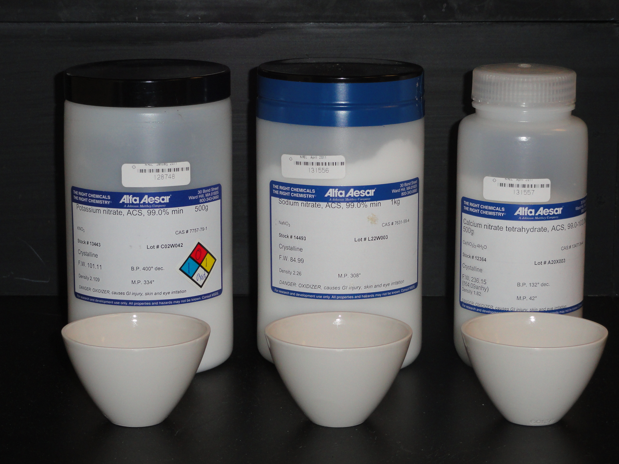

TES applied to CSP
4.3. Formulate New Molten salts Compositions
4. Under Research
(Ca(NO₃)₂, NaNO₃, KNO₃) salts mixture
From powder components pure at 99%
Under pure nitrogen in a glove box
Balance precise at 10⁻⁴ g
Mix during half an hour with ball miller
Glove box
Nitrates components
Ball miller
Dr. Nicolas CALVET

Slide 45

TES applied to CSP
Thermal stability
TGA
40°C - 700°C
At 20 K/min
200°C
500°C
Dr. Nicolas CALVET

Slide 46


TES applied to CSP
Thermal stability
* Measured at CIC Energigune with STA 449 F3 from NETZSCH Company
Dr. Nicolas CALVET

Slide 47

TES applied to CSP
Thermal cycling (Composition Nº6 NREL)
Melting temperature
DSC
30°C - 500°C
At 20 K/min
T_{m} = 116°C
200°C
500°C
Hitec XL® is stable on all the range of temperature of parabolic trough
Dr. Nicolas CALVET

Slide 48

TES applied to CSP
Viscosity measurements
Rheometer
=> Important parameter to pump the salt
Dr. Nicolas CALVET

Slide 49

TES applied to CSP
For more information about this work, please refer to this publication in the International Journal of Solar Energy Engineering
Dr. Nicolas CALVET

Slide 50
Under Research at MI
TES applied to CSP
Dr. Nicolas CALVET

Slide 51




TES Research Group Activity
Laboratory scale
TES Materials development
Pre-commercial scale
TES Systems Development
Thermal Properties Characterization Laboratory
Masdar Institute Solar Platform (MISP), 100 kW_{th}
Dr. Nicolas CALVET

Slide 52

TES Research Group Objectives
TES 24%
TES - 80%
Reduce significantly the cost of TES systems
Increase the working temperature up to 1000 C
Propose Sustainable TES Solutions
Source: US DOE
Dr. Nicolas CALVET

Slide 53






TES Research Group Current Structure
TES Group Leader – Dr. Nicolas Calvet
Postdoctoral Researchers
Dr. Mathieu Martins
Dr. Benjamin Grange
Alberto Crespo Iniesta
Miguel Diago Martinez
Uver Villalobos
Ms. Kholoud Al Naimi
Open Positions:
2 Ph.D.
Mahmoud Alzoubi (Ph.D)
Students
Research Associate
Dr. Thomas Delclos
Dr. Thomas Delclos
Dr. Thomas Delclos
Research Engineer
Dr. Bruno Cardenas
Victor Gutierrez Perez
Victor Gutierrez Perez
TCES
Projects
SANDSTOCK
NEST
iWaste
CSPonD²
CSD
Dr. Nicolas CALVET

Slide 54


TES Research Group Activity
1. Sand Particles Solar Receiver/TES system
Alberto Crespo Iniesta (M.Sc.), Miguel Diago Martinez (M.Sc.), Dr. Thomas Delclos, Pr. Tariq Shamim, Dr. Quentin Falcoz (PROMES).
In collaboration with
Heat Exchanger
Dr. Nicolas CALVET
Notes:
Following idea of sand hourglass
Remove sand and change capital letters

Slide 55

TES Research Group Activity
1. Sand Particles Solar Receiver/TES system
Alberto Crespo Iniesta (M.Sc.), Miguel Diago Martinez (M.Sc.), Dr. Thomas Delclos, Pr. Tariq Shamim, Dr. Quentin Falcoz (PROMES).
=
+
+
1 single material
Cold Tank
Beam Down Concentrator
Direct heat collector
Heat transfer
Storage
material
Hot Tank
Heat Exchanger
Dr. Nicolas CALVET

Slide 56

TES Research Group Activity
Dynamic Measurement Under Concentrated Flux
Conical distributor
Solar conical receiver
Moving sand bed
Conical distributor
35 º
Insulation
Solar conical receiver
Position of thermocouples
Hot tank
Position of thermocouples
Dr. Nicolas CALVET

Slide 57




TES Research Group Activity
2. High-Temperature Concrete Storage
Dr. Mathieu Martins, Uver Villalobos, Dr. Peter Armstrong, Dr. Paal Bergan (NEST), Dr. Christopher Greiner (NEST).
Main features of NEST:
Scalable
Versatile
Low cost
Efficient
Durable and safe
In collaboration with
BDOE current solar receiver
HTF: Synthetic Oil (T_{max} = 393 C)
Oil loop + Air-cooling system
Objective:
Test a 500 kW_{th}h prototype in real conditions of solar radiation
Dr. Nicolas CALVET

Slide 58



TES Research Group Activity
3. Industrial Waste Recycled as TES Materials
Ms. Kholoud Al Naimi (M.Sc.), Dr. Thomas Delclos.
In collaboration with
- Furnace slag (EAF & LF)
- Aluminum Dross
- Pot skimming
Thermal Stability
365,000 tons of slags produced per year in the UAE
Aluminum Dross
Dr. Nicolas CALVET

Slide 59
TES Research Group Activity
Solar Receiver
On the ground
Objective:
Develop new Combined Solar Receiver/TES systems
Higher temperature
Higher efficiency
Dr. Nicolas CALVET

Slide 60

TES Research Group Activity
4. CSPonD²
Dr. Benjamin Grange, Dr. Saif Saeed Al Mheiri, Pr. Tariq Shamim, Dr. Peter Armstrong, Dr. Thomas Delclos, Dr. Mamoun Medraj.
Pr. Alexander Slocum, Pr. David Trumper, Pr. Charles Forsberg, Dr. Tom McKrell, Dr. Danny Codd (MIT).
In collaboration with
Dr. Nicolas CALVET

Slide 61

Thank You
ncalvet@masdar.ac.ae
Dr. Nicolas CALVET
Version 1

